Slide 1
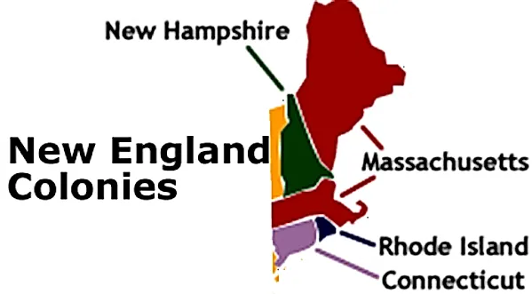
Early Colonization
Part 6-
New England Colonies

Slide 2
Brain Starter
What are some reasons that would cause you to move far away to a different area?

Slide 3
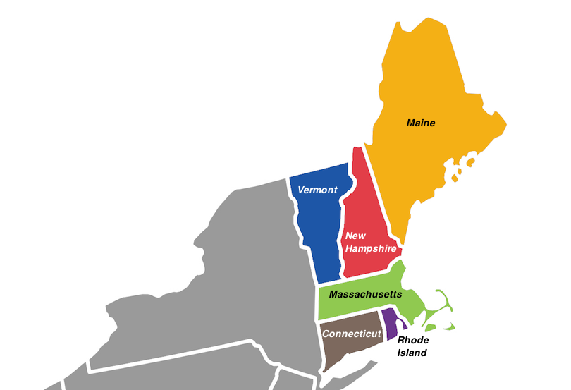
While exploring in 1614, John Smith named the region of what is today the northeastern part of the U.S. New England.

Slide 4
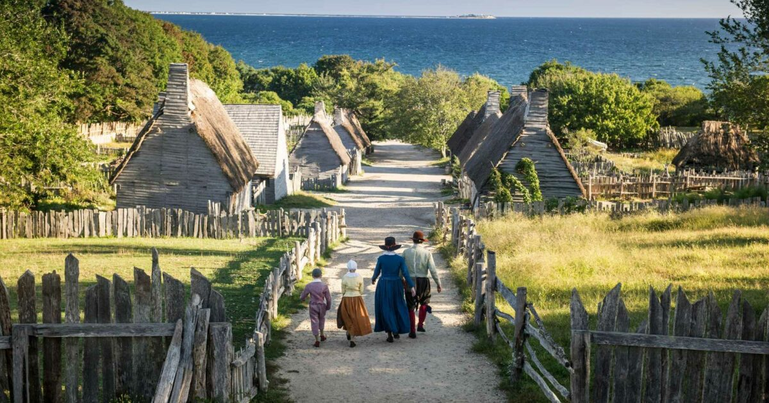
In 1620, Separatists from England formed the Plymouth colony near Cape Cod in present day Massachusetts.

Slide 5
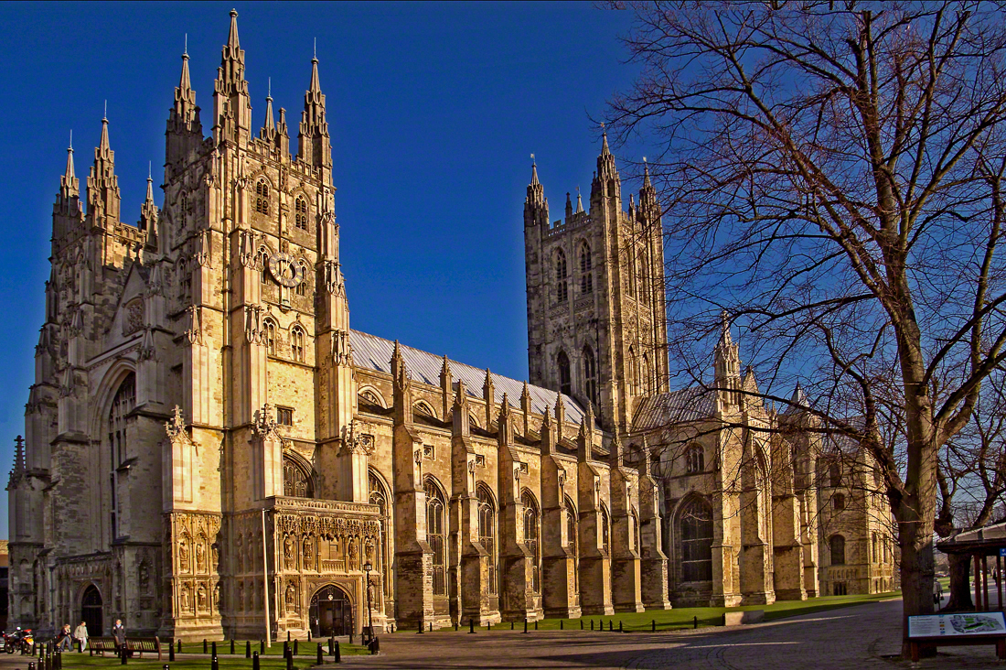
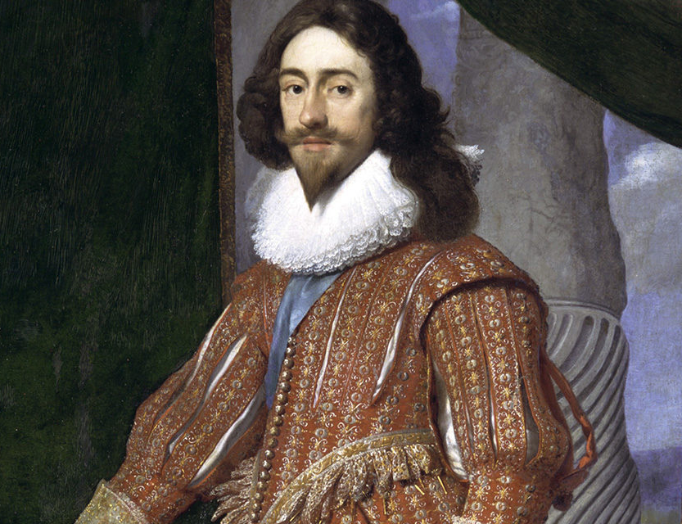
During the 1620s many Puritans were unhappy with life in England because they did not agree with the Church of England and King Charles I insistence of everyone worshipping the same way.

Slide 6
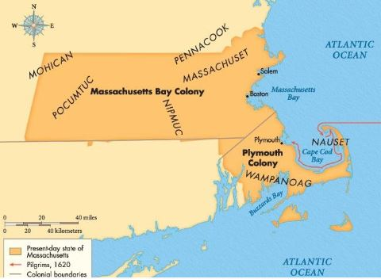
In 1629 the Massachusetts Bay Company was given a charter to settle land in New England. Many Puritans saw this as a way to form a community based on their ideals.

Slide 7
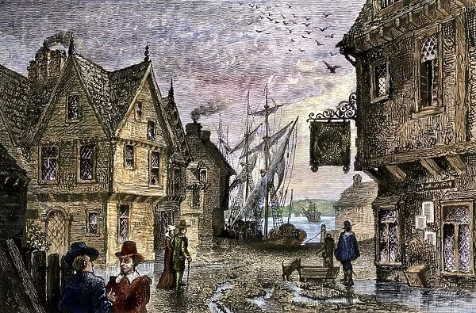
In 1630, 700 emigrants, mostly Puritans, left Europe for the new Massachusetts Bay Colony. They formed the town of Boston.
An emigrant is a person who leaves one place for another.

Slide 8
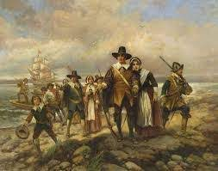
John Winthrop was picked as the governor of the colony. Over the next several years over 20,000 Puritan emigrants came to the Massachusetts Bay Colony. This is known as the Great Puritan Migration.

Slide 9
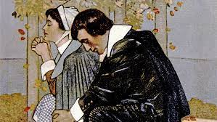
This new colony would be a commonwealth, a community in which people work together for the good of the whole. Its rules and laws were based on Puritan beliefs. They believed they had a covenant with God to build a holy society.

Slide 10
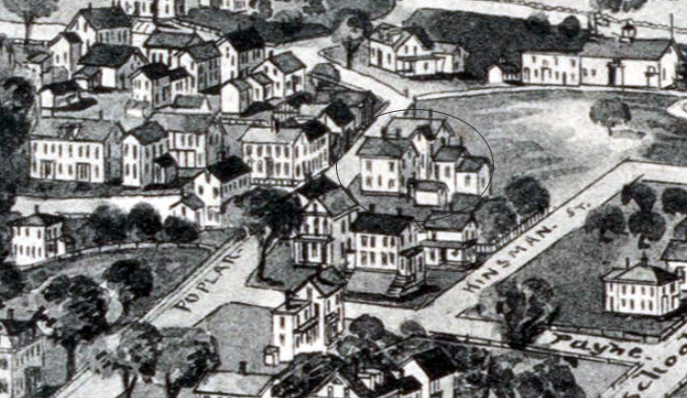
Puritan congregations (a group of people who belong to the same church) set up their own towns. Each town was built around an open area called a common.

Slide 11
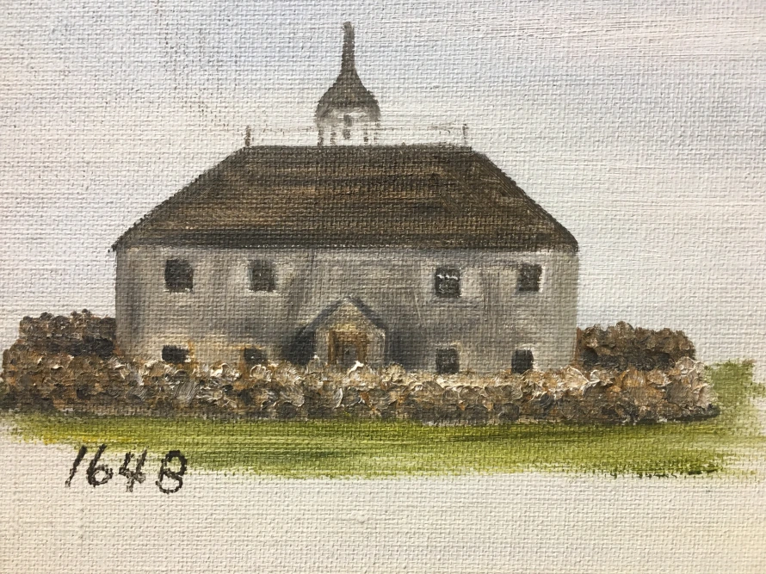
The most important building in these towns was the meetinghouse. This is where the townspeople had church services and town meetings where decisions for the community were made.

Slide 12
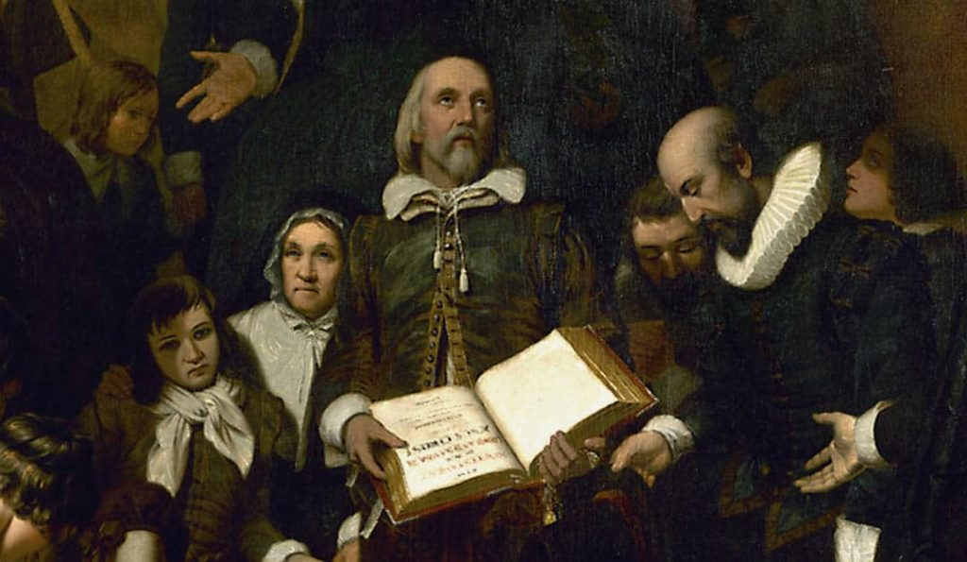
Puritans were very strict. Everyone had to go to church and learn about the “New England Way”. This was a term used to describe the society they were trying to build emphasizing duty, godliness, hard work, and honesty.

Slide 13
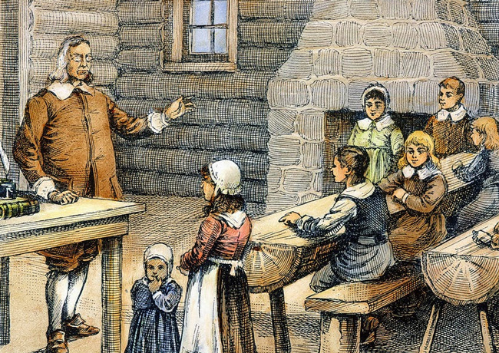
The “New England Way” was dependent on reading the Bible which led to an emphasis on education and literacy.

Slide 14
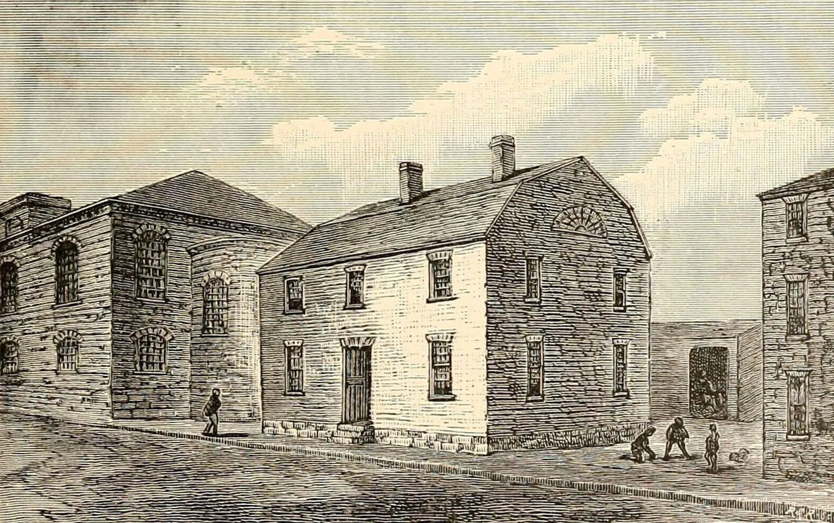
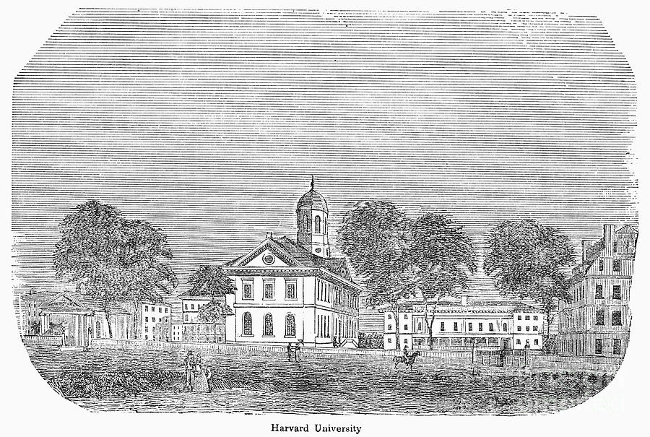
Harvard College was founded in 1636 to train ministers.
The Boston Latin School was established in 1635 and is the oldest public school in the U.S.

Slide 15
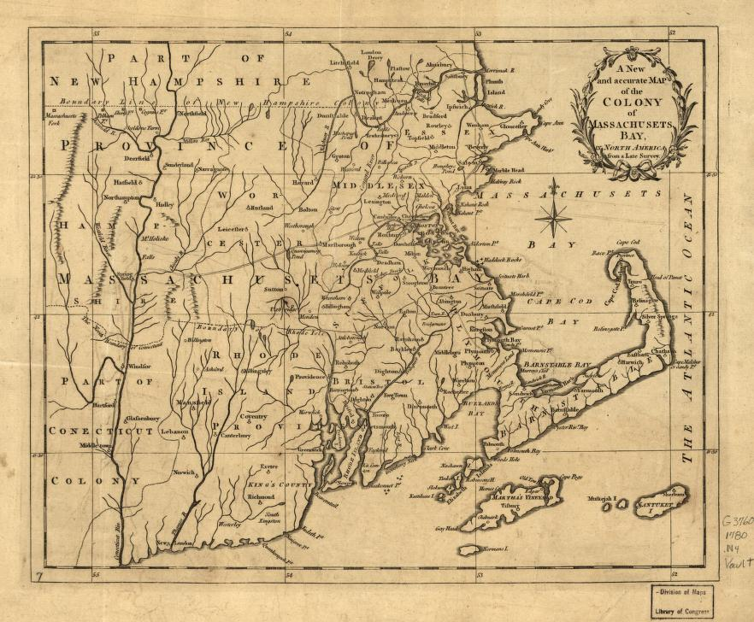
Massachusetts Puritans continued to spread out and build towns farther and farther from Boston.

Slide 16
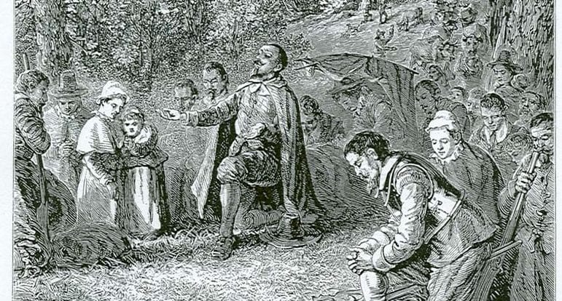
Thomas Hooker was looking to move his congregation out of Massachusetts because he was looking for religious freedom from the strictness of the Puritans.

Slide 18
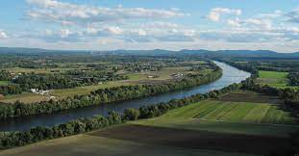
Thomas Hooker and his congregation moved to the Connecticut Valley in 1636. In 1639 the Fundamental Orders of Connecticut were adopted, forming the colony of Connecticut.

Slide 19
The Fundamental Orders of Connecticut was a set of laws that is often referred to as the first Constitution in America. It gave its citizens many rights and freedoms that we have today in the United States.

Slide 20
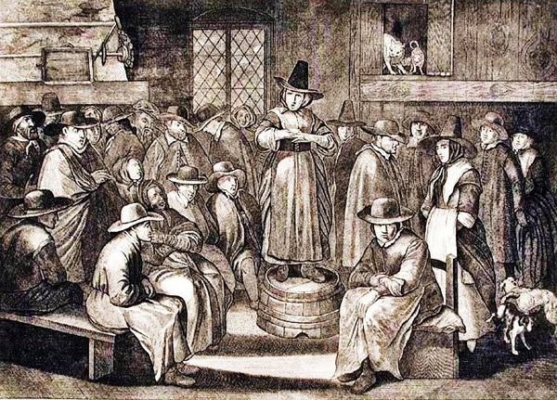
Other dissenters (someone who challenged the views of Church or society) became very well-known.

Slide 21
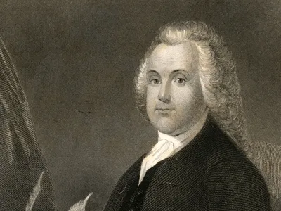
Roger Williams, a minister from the town of Salem, Massachusetts, was expelled for his views. He believed that the king had no right to give away the Native Americans’ land. He also felt that the government should have no power over religious matters.

Slide 22
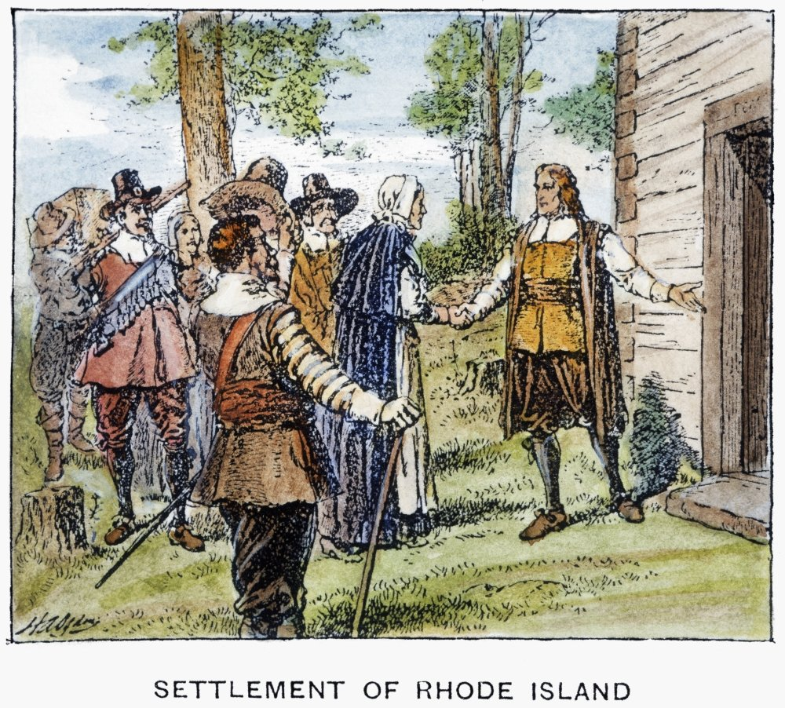
With a group of supporters, Williams ended up starting the colony of Rhode Island in 1636.

Slide 23
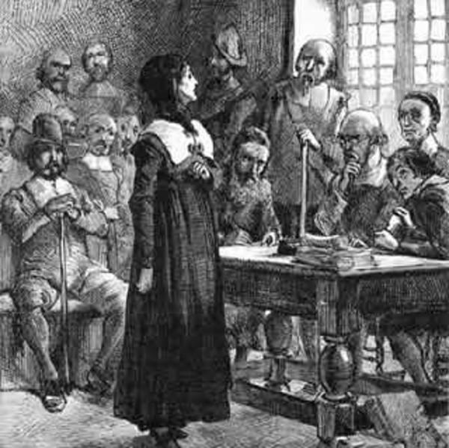
Anne Hutchinson was another famous dissenter. She was banished for her views in 1638. She went to Rhode Island along with a group of her followers.

Slide 24
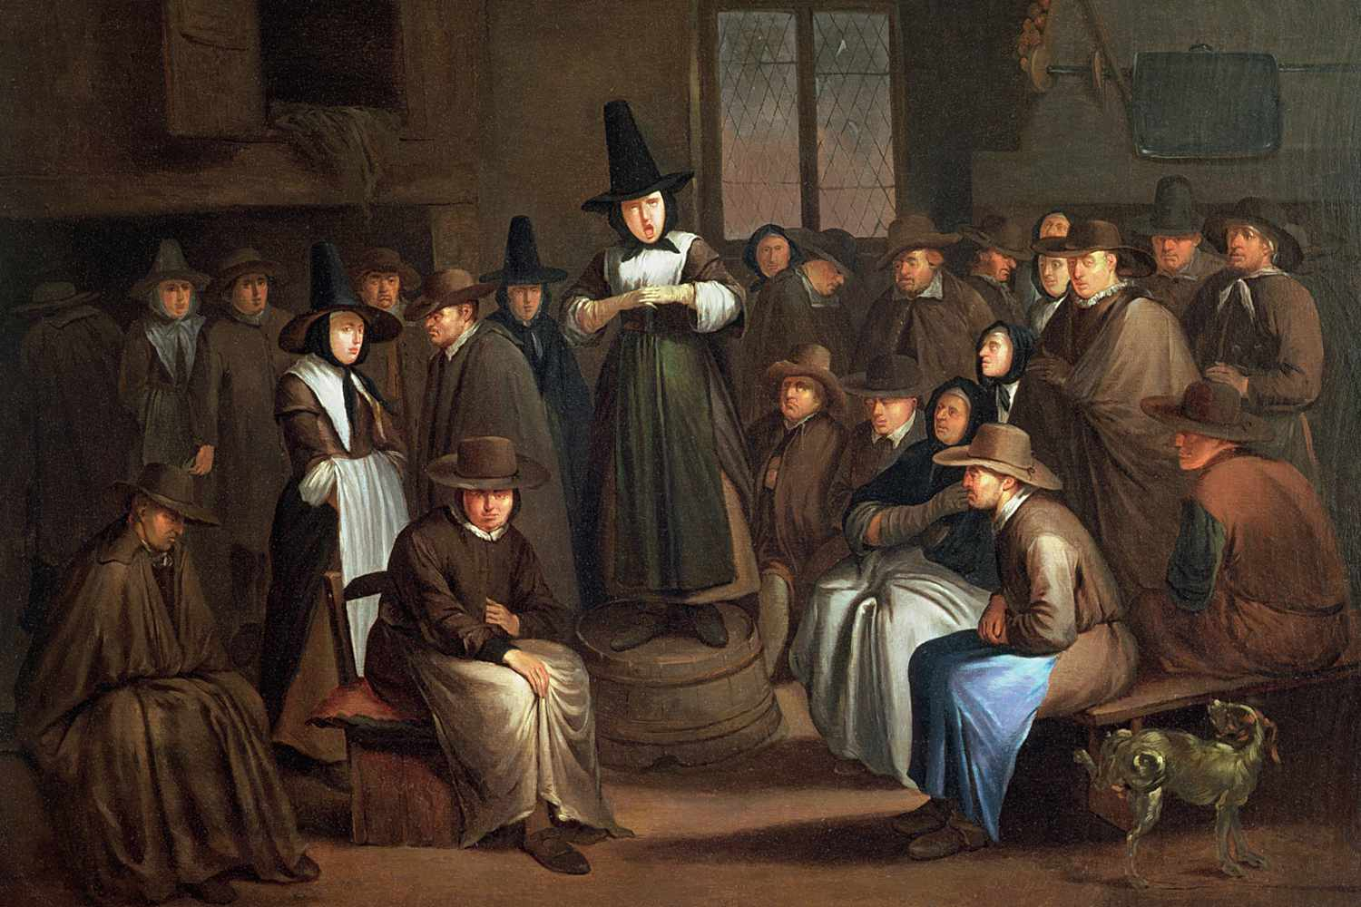
Quakers were another religious group that were persecuted in England and then in Massachusetts when they came to America seeking religious freedom.

Slide 25
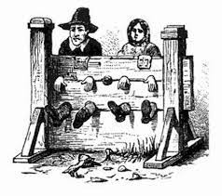
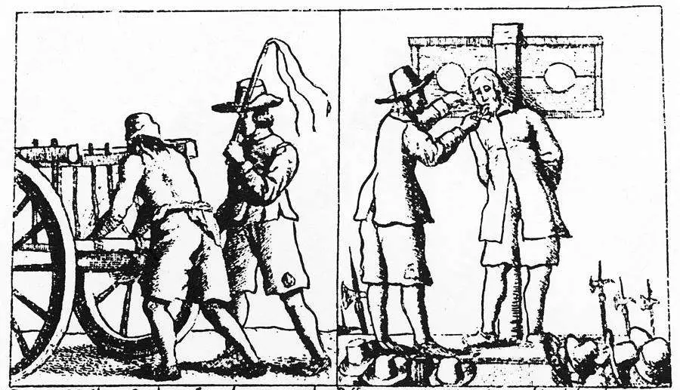
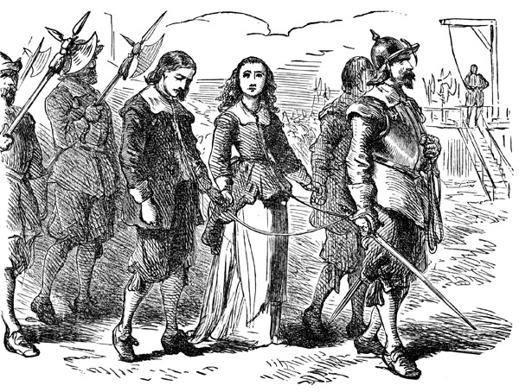
It got so bad for the Quakers that the king had to step in to stop the treatment of the Quakers.

Slide 26
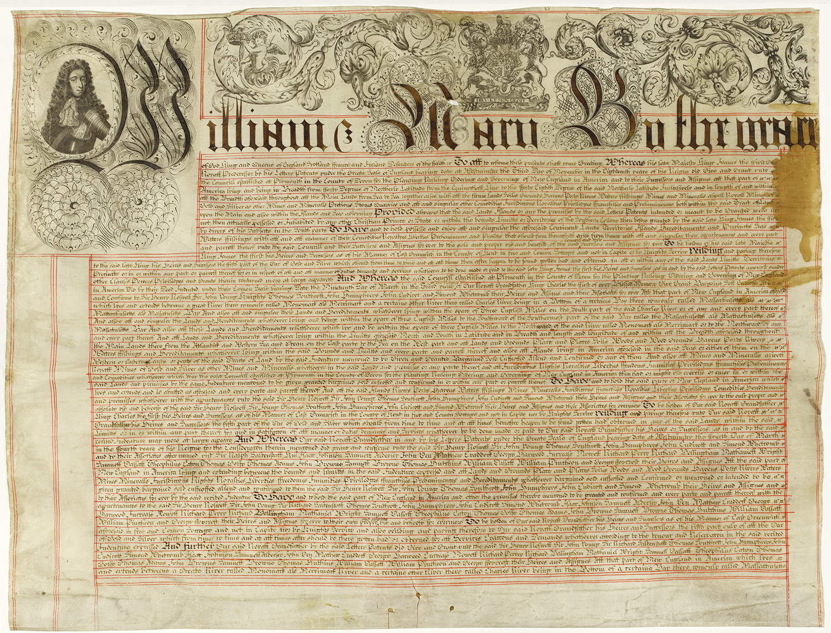
In 1691, the Puritan commonwealth came to an end. The king forced a new charter on Massachusetts which took away much power of the Puritans. The king now chose the governor and the right to vote was tied to land ownership, not church membership.

Slide 27
Exit Question
Why do you think the Puritans, who were persecuted for their religious beliefs, persecute others who challenged their views?

